Slide 1
QUALITATIVE ANALYSIS OF THE
DIVERSITY AND EQUITY CAMPUS CLIMATE SURVEY
Everett Community College
March 6, 2023

Slide 2
DEBRA BRAGG
Debra D. Bragg, Ph.D. is President of Bragg & Associates, Inc., an equity-minded consulting group dedicated to advancing student success in education and employment. In 2016, she founded the Community College Research Initiatives (CCRI) group at the University of Washington, and prior to that time, she was an endowed professor of higher education and founding director of the Office of Community College Research and Leadership (OCCRL) at the University of Illinois at Urbana-Champaign.

Slide 4
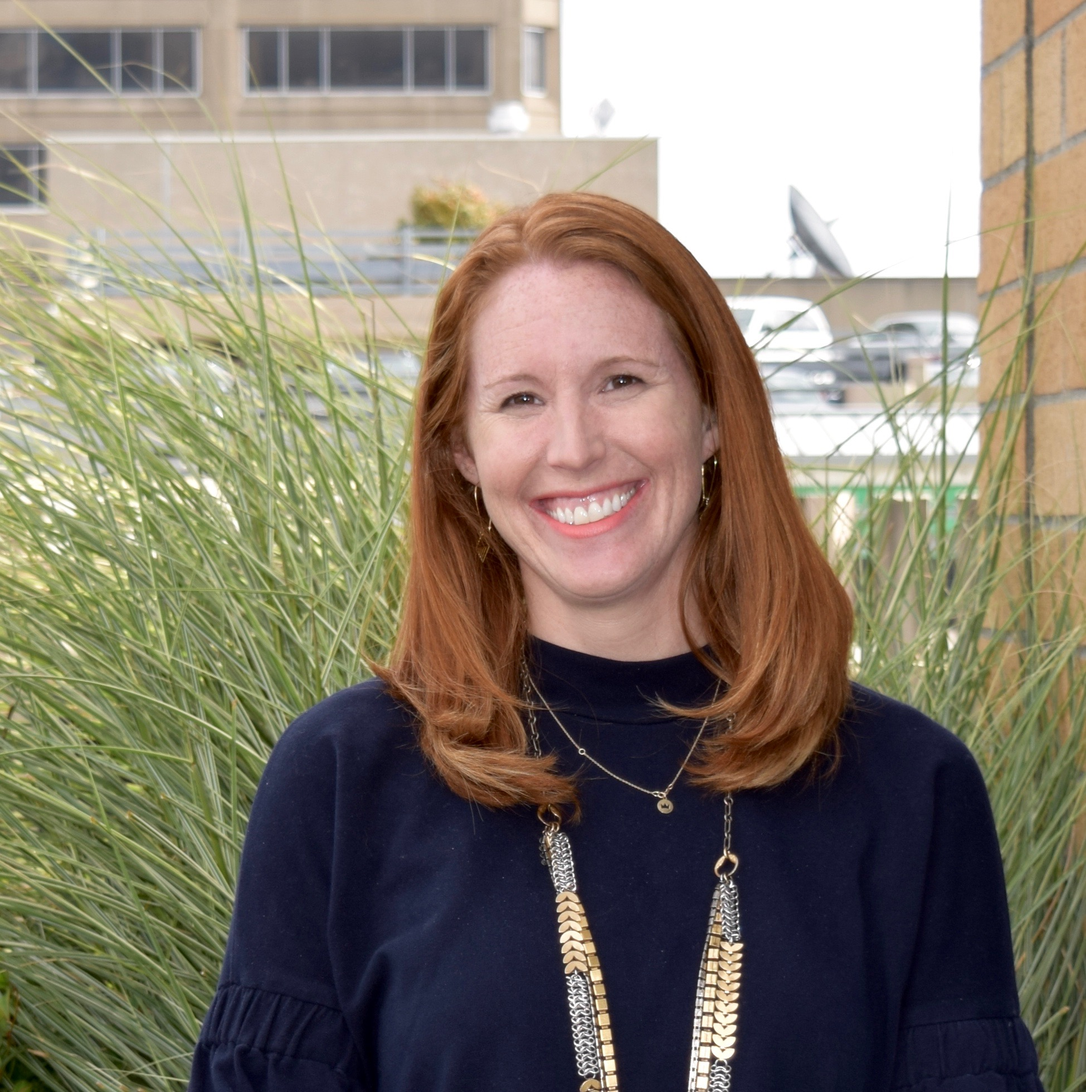
ELIZABETH MEZA
Elizabeth Meza, Ph.D. is a senior research scientist at the University of Washington Evans School of Public Policy & Governance. Before becoming an education researcher, Dr. Meza was a community college practitioner and served in administrative roles and as a Sociology faculty member at several community colleges in Washington state. Her research agenda seeks to identify and address inequities that hinder American higher education from delivering on its promise of equity, and centers community colleges as engines for opportunity and workforce development. Dr. Meza is the New America Education Policy Program Fellow for Community Colleges.
lll

Slide 5
WHAT DO EVCC RESPONSES TO OPEN-ENDED SURVEY QUESTIONS TELL US ABOUT CAMPUS CLIMATE?

Slide 6
OVERVIEW OF THE QUALITATIVE RESEARCH APPROACH
Review the Diversity and Equity Campus Climate Survey [Higher Education Data Sharing (HEDS) Consortium] process
Review Campus Climate survey results (e.g., HEDS report, EvCC powerpoint delivered to campus Fall 2022)
Conduct qualitative data analysis (thematic and pattern coding)
Present finding to EvCC’s Equity and Social Justice Committee

Slide 7
EVCC SURVEY RESPONDENTS SOURCE: EVCC/HED SURVEY ANALYSIS
Respondents and response rate by role
Respondent role by gender, race/ethnicity profile, and years of employment
Overall findings on campus climate – sense of belonging
More EVCC/HED survey quantitative findings in Appendix

Slide 8
RESPONDENTS AND RESPONSE RATE BY ROLE
The total college participation rate is 9%, with a margin of error of 3% (95% confidence interval). The margin of error varies by respondent role, with Students at 5%, Faculty at 7%, and Staff/Admin at 6%.

Slide 9
RESPONDENT ROLE BY GENDER

Slide 10
RESPONDENT ROLE BY RACE/ETHNICITY PROFILE

Slide 11
RESPONDENT ROLE BY YEARS EMPLOYED BY EVCC

Slide 12
OVERALL CAMPUS CLIMATE SURVEY FINDINGS
64% of EvCC respondents were satisfied or very satisfied with “campus climate” compared to 80% public 2-year institutions (80%) and 73% all institutions
50% of EvCC respondents were satisfied or very satisfied with “experience of community” compared to 66% public 2-year institutions and 51% all institutions
47% of overall EvCC respondents agreed or strongly agree that the campus is “free from tensions related to individual or group identity” compared to 65% public 2-year institutions and 44% all institutions
18% of overall EvCC respondents responded yes to having experienced discrimination or harassment compared to 13% public 2-year institutions and 19% all institutions

Slide 13
MAJOR QUALITATIVE FINDINGS SOURCE: CONSULTANT ANALYSIS

Slide 14
QUALITATIVE FINDINGS BY ROLE
*Concerning results were found for three groups on campus climate, experience of belonging, tensions with identity, and discrimination and harassment.
Faculty data showed a slightly lower level of concern than the Staff & Administration group but still concerning
Staff/Administration had the highest level of concerning results
Student demonstrated the lowest level of concerning results of all three groups
Understanding these results and what they may mean for EvCC’s employees and students is a primary focus of this qualitative study.
*Concerning = qualitative responses expressing worry, anger, discomfort, anxiety, fear, or other troubling or disturbing ideas

Slide 15
FACULTY

Slide 16
NUMBER FACULTY RESPONSES BY LEVEL OF SATISFACTION AND CONCERN WITH CAMPUS SENSE OF COMMUNITY

Slide 17
FACULTY RESULTS: WHAT ONE WORD OR SENTENCE WOULD YOU USE TO DESCRIBE “SENSE OF COMMUNITY” AT EVCC?
62 faculty reported Satisfied/ Very Satisfied, with 51% concerning statements (29) | collegial . belonging . diverse . fractured “Mostly collegial department; campus as a whole feels fractured.” “The college makes an effort to employ, retain, educate and assist people with diverse backgrounds and continues to strive to improve that effort.” “Honestly, I think I don't necessarily feel a sense of community across EvCC, but I feel 100% a sense of belonging and community on my team and in my division.”
50 faculty reported Neutral, with 88% concerning statements (44) | non-existent . disconnected . undervalued . well intended “I feel community among my colleagues in my program but disconnected from the larger campus community.” “In the wake of COVID, community is tenuous and administrative support for "equity" is ranked well below "budget".” “I used to feel a strong sense of belonging and being part of a community, but now it's hard to identify my 'community' because of all the structural/organizational changes and loss of so many people.”
30 faculty reported Dissatisfied/ Very Dissatisfied, with 90% concerning statements (27) | non-existent . undervalued . dysfunctional “I rarely feel a sense of community because sense of community involves acceptance, belonging, and feeling valued or respected.” “A dysfunctional family. Amazing colleagues that truly care for one another in a very dysfunctional environment.” “I feel a sense of community with some members of my department and my affinity group but there is no campus wide community.”
Notes:
102 /
134

Slide 18
EXAMPLES OF VERY CONCERNING STATEMENTS FROM FACULTY
“[I] find that equity and diversity is just a catch-phrase that everyone uses but never apply in real life. White Supremacy principles still guide the overall climate and work processes at EvCC.”
“[The] faculty I work with feel their freedom of speech is at risk because of the intolerance exhibited by individuals when it comes to discussing different viewpoints.”
“[U]pper management does not exhibit those same behaviors… I would give [describe] them as unappreciative, condescending, and unwilling to help others grow who have been working there for a long time.”
“[S]omething has changed the past two years and I no longer feel safe at all. This makes me very sad because I want to grow daily in my journey of equity.”
*Very concerning statements associate race, gender, sexual orientation, politics, religion, and other identities, roles and perspectives with fear, sadness, alienation, discrimination, and other worries for people on the EvCC campus.

Slide 19
FACULTY RECOMMENDATIONS “ONE CHANGE IS NOT ENOUGH TO FIX OUR PROBLEMS.”
Hire more tenured faculty, especially BIPOC, address inequitable workloads, ensure fair compensation, and improve the workplace environment. (20)
Address transparency, consistency, accountability, and access to EvCC administration/leadership (14)
Offer professional development and follow-through on EDI for faculty, staff and students (12)
Stop focusing on EDI, identities, politics, etc. (12)
Build community (relationships), including events and activities within and across different departments (11)
Increase and enhance communications by convening, dialoguing and listening across departments (10)
Focus on student supports, including financial needs (9)
Bring people back to campus and address lingering concerns about COVID (8)

Slide 20
STAFF/ADMIN

Slide 21
NUMBER STAFF/ADMIN RESPONSES BY LEVEL OF SATISFACTION AND CONCERN WITH CAMPUS SENSE OF COMMUNITY

Slide 22
STAFF/ADMIN RESULTS: WHAT ONE WORD OR SENTENCE WOULD YOU USE TO DESCRIBE “SENSE OF COMMUNITY” AT EVCC?
57 Staff/Admin were Satisfied/Very Satisfied, with 56% concerning statements (32) | comfortable . community in dept. but not campus . progressing “I can see that Everett Community College has started to recognize and address equity and social justice issues.” “I find a great sense of support and community in my immediate department but [I] feel disconnected and in some ways unsupported or understood from the greater campus.” “I have been mostly embraced by the community, but I am aware that this experience is not universal because people have shared their feelings and experiences with me.”
51 Staff/Admin were Neutral, with 92% concerning statements (47) | divided . undervalued . strained . splintered “Lukewarm: EvCC is open to diversity, but it is not quite ready to truly support Black, Brown, and Native student/faculty/staff/admin success…” “There are very strong pockets of communities at EvCC but the larger community feels very strained.” “EvCC talks a lot about diversity and community but lacks follow-through and support to enhance campus diversity and community.”
36 Staff/Admin were Dissatisfied/ Very Dissatisfied, with 97% concerning statements (35) | non-existent . siloed . uncomfortable . saddened “I do not feel a sense of community at EvCC.” “The past [few] years has made me question working at EvCC due to the lack of community feeling on campus.” “Hopeful there will be an increased sense of community here at EvCC, but I would say I don't feel that yet, especially working at a more isolated part of campus.”

Slide 23
EXAMPLES OF VERY CONCERNING STATEMENTS FROM STAFF/ADMIN
“Toxic towards BIPOC students and staff. It does not matter how many changes or trainings there are. Until those with the strongest voices retire and we hire more BIPOC staff, I don't think it will ever change.”
“I am a BIPOC staff member at EVCC and… I feel the microaggressions and racism that we experience on a daily basis are detrimental to our well-being and definitely our mental health.”
“Diversity on this campus currently alienates certain populations in favor of others.”
“Students face unintentional racial discrimination in the classroom daily. We need more racial and ethnic faculty representation that reflect the EvCC student population.”
*Very concerning statements associate race, gender, sexual orientation, politics, religion, and other identities, roles and perspectives with fear, sadness, alienation, discrimination, and other worries for people on the EvCC campus.

Slide 24
STAFF/ADMIN RECOMMENDATIONS “THOSE IN POWER NEED TO FIND WAYS TO INTERACT WITH THOSE WITH NO POWER.”
Build community (relationships), including holding events and activities and bringing people together to break down silos (25)
Hire more staff, especially BIPOC, address inequitable workloads, ensure fair compensation, and improve the workplace environment (18)
Address transparency, consistency, accountability, and access to EvCC administration/ leadership (14)
Improve communications, including listening leadership and groups across campus (14)
Offer professional development for staff, including onboarding for new personnel (12)
Depoliticize and reunify the campus (10)
Focus on EDI, prioritize and embrace the benefits of equity (7)
Enhance student supports, including financial, food insecurity and classroom microaggressions (7)

Slide 25
STUDENTS

Slide 26
NUMBER STUDENT RESPONSES BY LEVEL OF SATISFACTION AND CONCERN WITH CAMPUS SENSE OF COMMUNITY

Slide 27
STUDENT RESULTS: WHAT ONE WORD OR SENTENCE WOULD YOU USE TO DESCRIBE “SENSE OF COMMUNITY” AT EVCC?
231 students were Satisfied/Very Satisfied, with 11% concerning statements (26) | welcomed . safe . comfortable . inclusive “No matter where you come from, everyone is welcome.” “As a person of color I feel very safe at EVCC. I don’t feel any different from anybody.” “I think there are niches of community at the college.” “Still needs a lot of improvement on diversity and equity.”
50 students were Neutral, with 78% concerning statements (39) | non-existent . disconnected . alienating “There is diversity on campus, but I am not welcome in it.” “I don’t feel a sense of community at EvCC.” “I see an overemphasis on diversity, as if the college thinks it is failing if it's not diverse enough.” “I go to school to learn, not for the community.”
22 students were Dissatisfied/ Very Dissatisfied, with 91% concerning statements (20) | non-existent . unwelcoming . invisible “Diversity is over emphasized to the point of causing tribalism which is stamping out any narratives of unity that bind different groups together.” “I feel invisible; there are not many visibly queer people at EvCC, so my sense of community is lacking.” “Pro liberal, against conservatives! YUK.”

Slide 28
EXAMPLES OF VERY CONCERNING STATEMENTS FROM STUDENTS
Toxic. Professors and administrators need to embrace the change, they are the ones who are inequitable and have caused students to leave the campus. The students understand and embrace equity.
I feel invisible - there are not many visibly queer people at EvCC, so my sense of community is lacking.
Where I had my classes I was very careful not to be myself.
We need more work to help BIPOC students and paying attention to Muslim/Arab students.
Utterly alienating, I'm paying my hard earned money to learn about the subjects in the class description, not get preached at regarding whatever political/social issue the college and it's students…care about at the moment.
Mental health wise? The world is changing and we need help getting through it.
*Very concerning statements associate race, gender, sexual orientation, politics, religion, and other identities, roles and perspectives with fear, sadness, alienation, discrimination, and other worries for people on the EvCC campus.

Slide 29
STUDENT RECOMMENDATIONS ”I WOULD MAKE SURE ALL STUDENTS FELT WELCOME ENOUGH TO FEEL COMFORTABLE IN ASKING FOR HELP OR ASSISTANCE WHEN THEY NEED IT."
Involve students in community building, events and activities that bringing people together; engage and meet the needs of marginalized student groups (61)
Provide campus supports, services and resources to help students succeed (library, tutoring, parking, café, mental health, sports, etc.) (24)
Focus on academics, hold in-person classes, and offer resources and supports on campus (21)
Hold employees accountable for racism, bigotry, and biases; recruit more diverse students and hire more diverse faculty and staff, including Black leaders (14)
Reduce the focus on EDI (12)
Offer professional development that enables faculty and staff to better meet student needs (11)
Offer more co-requisite options (clubs, activities) (10)
25 students reported “no changes” needed

Slide 30
OVERALL RECOMMENDATIONS

Slide 31
RECOMMENDATIONS ACROSS ALL RESPONDENT GROUPS
Ensure diverse faculty & staff/admin hiring and retention, with fair compensation and rewards
Address concerns with administration transparency, accountability, and consistency
Build community (relationships) and improve communications across campus
Resolve divisions that get in the way of campus community and sense of belonging
Offer professional development on critical concerns for faculty, staff/admin, and students
Ensure student support and equitable success

Slide 32
EVCC NEXT STEPS

Slide 33
RESEARCH
CONSULTANTS
Debra Bragg, Ph.D.
Bragg.Associates.Inc@gmail.com
Elizabeth Apple Meza, Ph.D. Bethapple1@gmail.com
Joe Lott Jr., Ph.D.
jlott1@gmail.com

Slide 34
APPENDIX SUMMARY OF EVCC’S CAMPUS CLIMATE SURVEY PROCESS

Slide 35
APPENDIX SUMMARY OF EVCC’S CAMPUS CLIMATE SURVEY METHODS
EvCC addressed E2SSB 5227: Diversity in Higher Education requirement by administering the Higher Education Data Sharing (HEDS) Consortium’s Diversity and Equity Climate Survey (which was included in SBCTC’s list of surveys and recommended by EvCC’s Equity and Social Justice Committee
Survey conducted from 4/11/22–4/29/22 via email to all EvCC employees and all students over the age of 18
Survey data analysis conducted by the HEDS Consortium and EvCC researchers
Survey results presented to the campus at the start of the Fall 2022 quarter and feedback gathered regarding the meaning, merits and potential use of results
Decision made to conduct qualitative data analysis, including securing an external research team with prior experience with EvCC and Washington state community and technical colleges
EvCC’s Equity & Social Justice Committee:
Megan Blomquist
Lisa Corner
Erica Dias
Dana Harker
Jenny Marin
Heather Mayer
Renuka Prabhakar
Jose Reyes
Susanne Weatherly

Slide 36
Alignment of EvCC’s Survey Process with E2SSB 5227: Diversity in Higher Education
Campus Climate Assessments
Colleges shall each conduct a campus climate assessment every 5 years (at minimum) to understand the current state of DEI on campus for faculty, staff, and students.
Must post findings on public website.
Listening & Feedback Sessions
Colleges must conduct annual DEI listening and feedback sessions for the entire campus community.
Must compensate students for their participation and post findings on public website.
Professional Development & Training
Provide DEI/anti-racism training to faculty, staff, and students.
Create an evaluation for the participants.
Share completed evaluations and other program information with SBCTC annually.
Post DEI training framework on public website.
Notes:
3 key components/deliverables:
Colleges must conduct campus climate survey/assessments:
Conducted every 5yrs; listening and feedback sessions conducted annually
Professional Development & Training:
Training can be existing or new, and developed in partnership with faculty, staff, and students; Create an evaluation for the participants.
Wherever possible, colleges are encouraged to conduct their climate assessments by July 1, 2022 in order to be best positioned to use their findings to inform their DEI strategic plans and professional development training.

Slide 37
THE HEDS DIVERSITY AND EQUITY CAMPUS CLIMATE SURVEY
The HEDS Diversity and Equity Campus Climate Survey asks students, faculty, staff, and administrators about:
perceptions of the institution’s climate,
perceptions of how the institution supports diversity and equity, and
experiences with discrimination and harassment at the institution.
Additional details about the survey are available at: https://www.hedsconsortium.org/wp-content/uploads/2022-2023_HEDS_Diversity_Equity_Info_Sheet.pdf

