Slide 1
THINK OUTSIDE THE BOX -PRACTICE PARADOX
Presented by Beffie williams
Notes:
Hello, everyone! My name is Beffie Williams, and I’ve been with Everett for a little over 4 years. I am an instructor for the Medical Transcription & Editing and Coding Programs. The Connection I’ll be focusing on today is Practice Paradox. This connection blends structure and flexibility in the classroom.

Slide 2
Students need structure in the classroom.
S
T
R
U
C
T
U
R
Expectations
Course Work
Mutual Respect
Integrity
Due Dates
E
Clearly communicate expectations and requirements.
Notes:
At the beginning of the quarter, it’s really important to let students know what your expectations are as an instructor. In my classes, I have everything laid out – the course work, due dates, academic integrity, and respectfulness in the classroom – everything that will allow students to know what they’ll need to make the quarter go smoothly. But I also let them know what they can expect from me – when my grading will be completed, all of the ways to contact me, how to set up a phone conference, the various ways I’ll be communicating with them – everything they need to know about me and how I’ll be participating in their learning experience. For me, it’s imperative that each student feels like they are important and their needs will be met in order to be successful, especially since I teach fully online.

Slide 3
Today, we’ll be FOCUSING ON …
Expectations
Course Work
Respect
Integrity
Due Dates
Due Dates
Notes:
Today, we’ll be focusing specifically on due dates and the timelines the students are given to turn in their assignments. In my classes, students know the due date is always Sunday at 11:59 p.m. I have a Time Management Policy in place that outlines the details of how I handle work that’s turned in late. Again, the structure is there so they know what to expect and what I expect of them.

Slide 4
PERSONAL DAY BADGES
Notes:
But in my classes, I use personal day badges. I use the Badgr app to create the Badges, and it works seamlessly with Canvas. The setup is fairly easy and there is very little work I have to do throughout the quarter to keep up with the logistics of used and unused personal days.

Slide 5
WHAT ARE PERSONAL DAYS?
Personal days give students the FLEXIBILITY to turn assignments in a little late if a personal issue arises
F
L
E
X
I
B
I
L
I
T
Y
Notes:
Personal days are something I use in my classes to give students a little FLEXIBILITY if they run into issues during the week and need to turn assignments in a little later than the due date. Just a quick little overview of how this works - I give each of my students 3 personal days at the beginning of the quarter that can be used when assignments are turned in late. 1 badge equals 1 personal day. If a student turns in their assignment 1 day late, 1 badge is used. 2 days late, 2 badges are used, etc. At the end of the quarter, each unused badge will earn 2 extra credit points, so if a student has 3 badges, they get 6 points, 2 badges = 4 points, and 1 badge = 2 points. And of course, if they’ve used all their badges, they won’t get any extra credit points.
Just as an aside, the way I set up personal days is by using the due dates, not the number of assignments that are due. For example, if three assignments are due Sunday and all 3 assignments are turned in on Tuesday, two badges would be revoked because the assignments are 2 days late.
On another note, when all the badges are used up, or if a student turns in an assignment more than 3 days late, the Time Management Policy protocols will apply to those assignments.

Slide 6
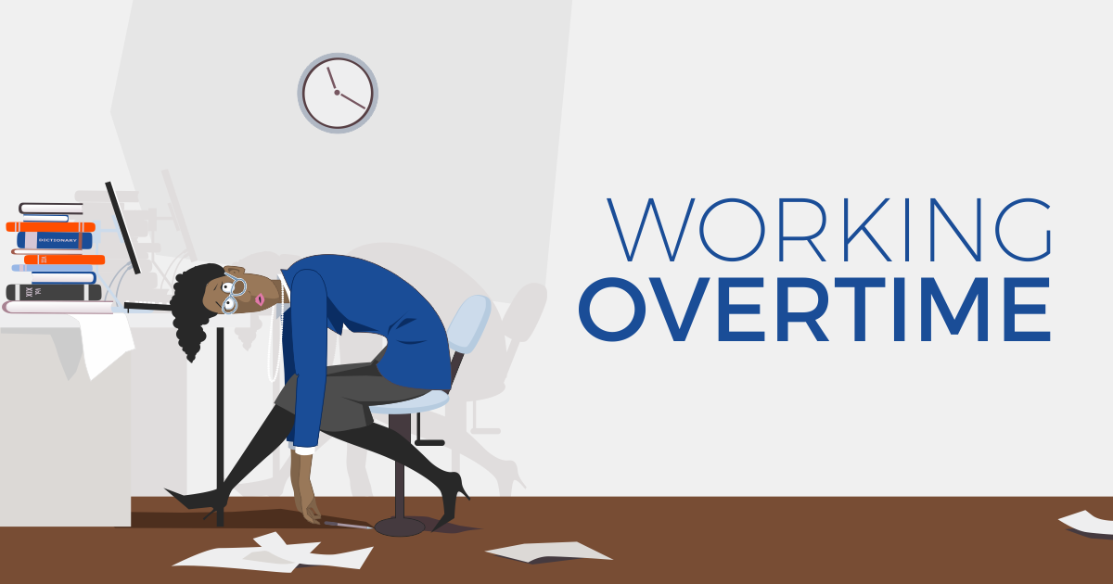
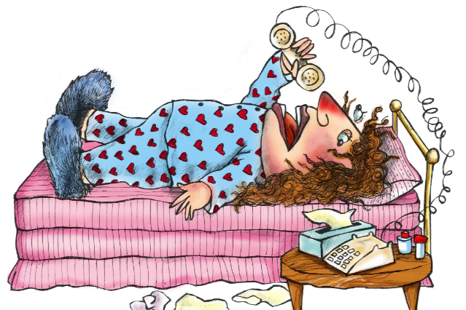
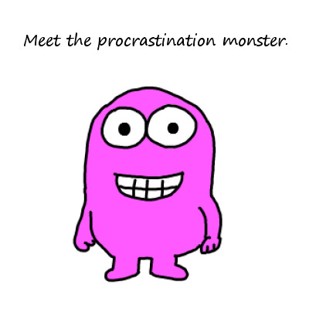
Why do I use personal days?
Notes:
Okay, so why did I begin using personal days? I’ve always been very willing to offer students an extension when an issue arises, but I’d gotten to the point where I didn’t want to determine whether a student’s lateness was truly legitimate. Did their internet REALLY go out? Were their kids really sick? Did they really have to work overtime? So, I began offering personal days, and that worked very well. The only drawback was that I had to keep track of student’s personal days using a spreadsheet. Then at the end of the quarter, I had to go in and apply the extra credit. One quarter, I forgot to add in the extra credit. Thankfully, a student pointed it out, so it didn’t cause any real issues, but the potential was there! So, that’s when I began using Badgr and issuing badges at the beginning of every quarter. I can go into the gradebook, revoke the badge, and add a note that a personal day was taken in a specific week, and Canvas does the rest. Plus, I have everything in one place. It has worked out extremely well, and the students really like the badges, too.

Slide 7
Less rigid and authoritative
Personal Day Badges Give Students Some Control
More kind & compassionate
C
O
N
T
R
O
L
Notes:
Aside from the ways using Personal Day Badges helps me, I’d like to take a look at how they help students. In addition to the flexibility I talked about earlier, they also give students some control over their learning experience. Real life is going on outside the classroom – stuff happens, even if it is procrastination – rather than being rigid and authoritative, I can show a kinder, more compassionate side in the classroom. Students deserve a little grace, and the badges do just that. Students can decide whether they want to save up their days and earn the extra credit or use the days when they hit a snag along the way.

Slide 8
Creates a less stressful learning environment
Fosters the student’s ability to learn effectively.
F
O
S
T
E
R
S
L
E
A
R
N
I
N
G
Notes:
Although I emphasize the importance timeliness throughout the quarter – I put reminders out there all the time because it is important to stick to a schedule and get things done - the badges eliminate some of the stress and pressure they feel to get things done on time, which in turn fosters their ability to learn effectively because they don’t feel rushed. If they have been extremely busy or stressful during the week, knowing they have a little bit of cushion it just helps relieve some of the stress they feel. I can’t tell you the number of times students have told me they appreciate having that little bit of extra time, and they immediately get back on track the following week. So, the leniency doesn’t create an environment where students feel like they can slack off and continually fall behind, it gives them the breather they needed for a brief moment, then they jump back in and get things done on time.

Slide 9
What do students have to say?
Notes:
I surveyed 2 of my classes regarding my use of personal day badges – I surveyed my first year students and my students who will be graduating this quarter or next.
Among other things, I asked the following question:
In your own words, please answer the following questions:
How will Personal Days benefit you this quarter?
What do you like or dislike about the use of Badges?

Slide 10
By knowing that as I adjust to being back in college and relearn how to study and manage my time, I know that if I do miscalculate or catch a cold or struggle in any number of ways I have a small safety net that allows me to maintain my GPA
If things get out of control, or I get sick, it's nice to know I can take an extra day for assignments without screwing up my grade, or having to email and beg for an extension.
I am hoping I do not need to use them so I can have those extra points go towards my grade. I do like the fact that they are there in case I hit a snag in my work. But I like to pretend I do not have a fail safe and that I MUST keep up on my work.

Slide 11
I personally like the badges and think they're a great addition. Sometimes life gets a little hectic and we have no control over certain situations.
Personal days are an awesome provision to take advantage of if unexpected situations or sickness come up. It's really nice to know I have that available in case I have a crazy week and need an extra day to catch up.

Slide 12
I like the badges because it gives me peace of mind knowing that if something comes up in my life that I can take a personal day if I need to.
I can't think of anything that I dislike about the Badges at this time.
I like seeing the badges because it gives you a sense of accomplishment.

Slide 13
Beffie williams
bwilliams@everettcc.edu
Notes:
If you have any questions about Personal Days or setting up Badgr, I’ll be happy to help. I’m not an expert by far, but I had so many trials and errors that I can at least guide you to through the process and let you know what will and won’t work. Feel free to reach out to me!

