Slide 1
True Connections
Tips & Tricks to Know Each Student

Slide 2
Activities that stimulate Creative, introspective and aspirational sharing

Slide 3
Activity Examples
Creative - Introspective - Aspiration
Personal Flags
Personal Shields
SMART Goals

Slide 4
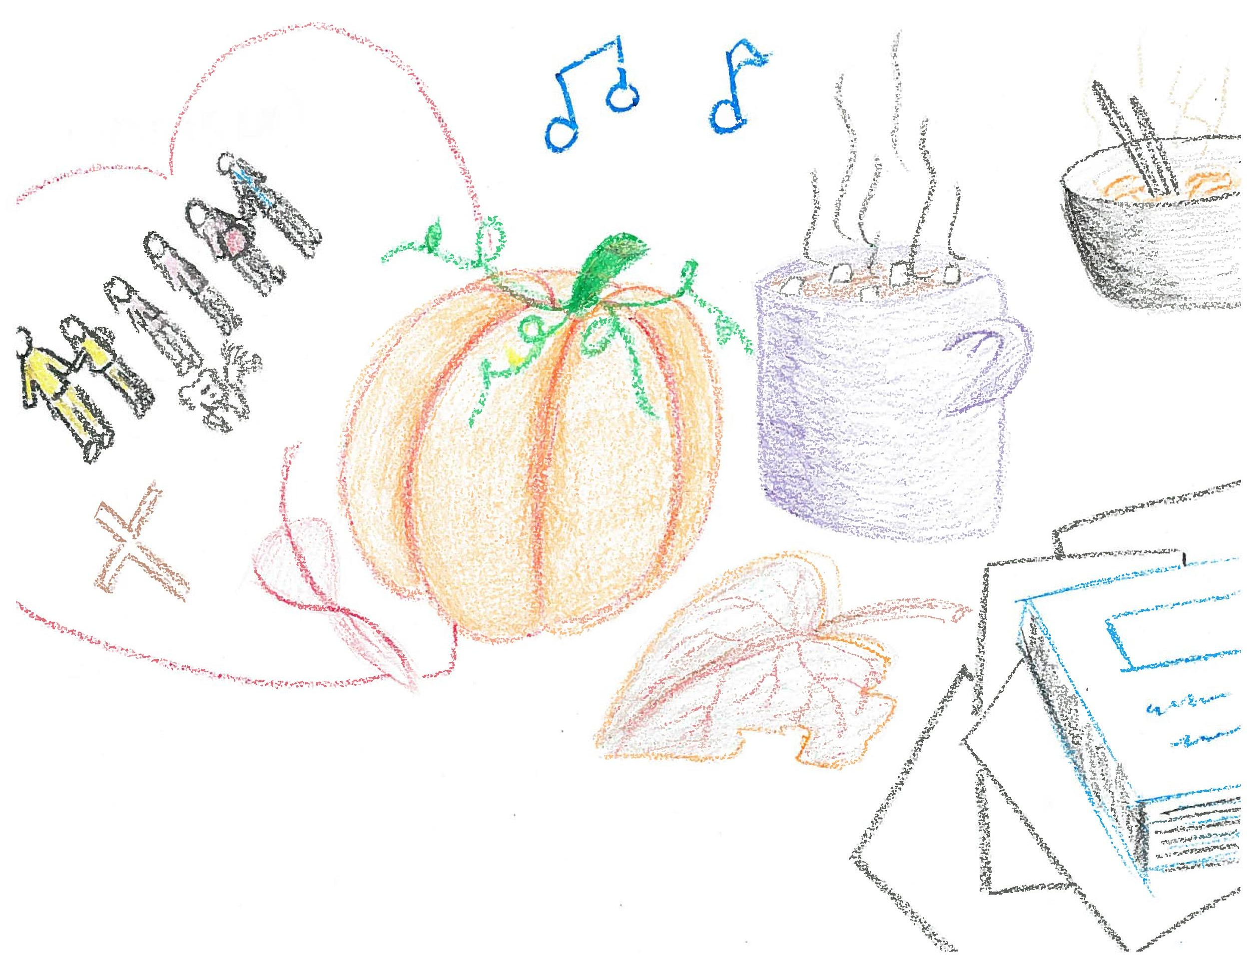
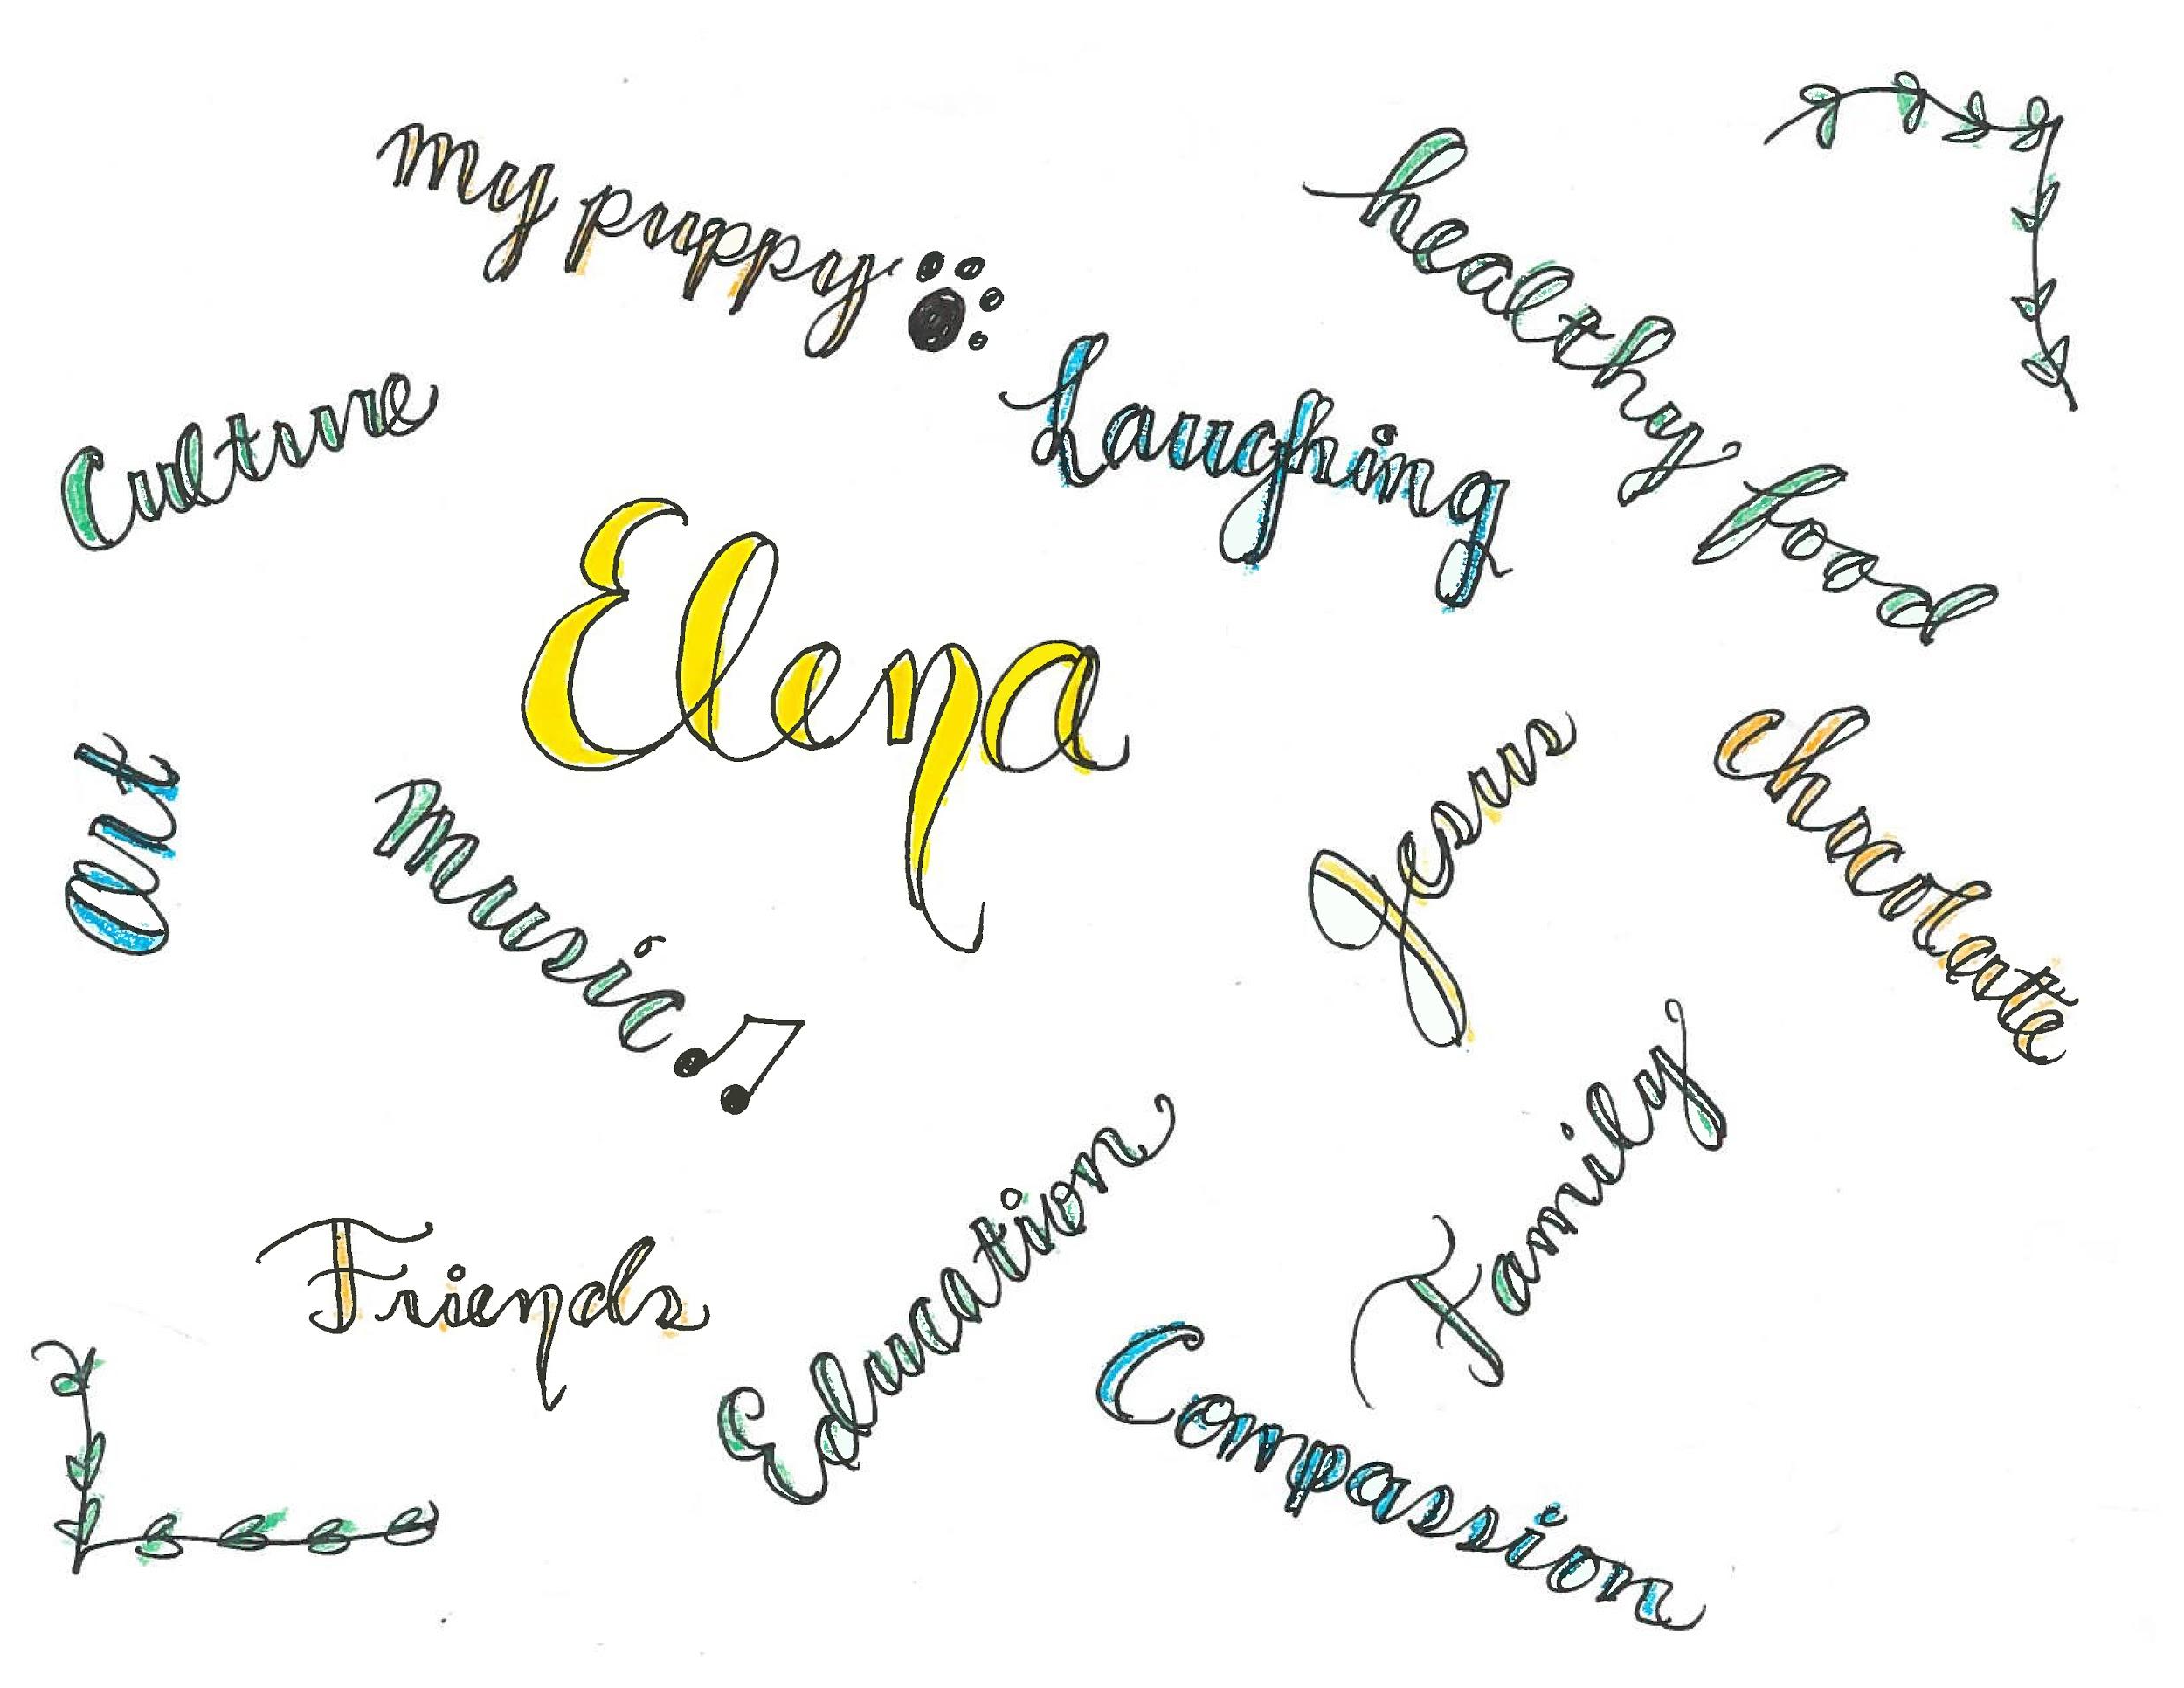
Personal Flag Activity

Slide 5
Things to Note
This is a creative activity, with open interpretations
Recommend doing it in class. You can collect the art and use in one-on-ones.
Great way for students to learn about other students. Build community in class.
Always acknowledge and thank everyone who shares.
Share your own.

Slide 6
Personal Shields

Slide 7
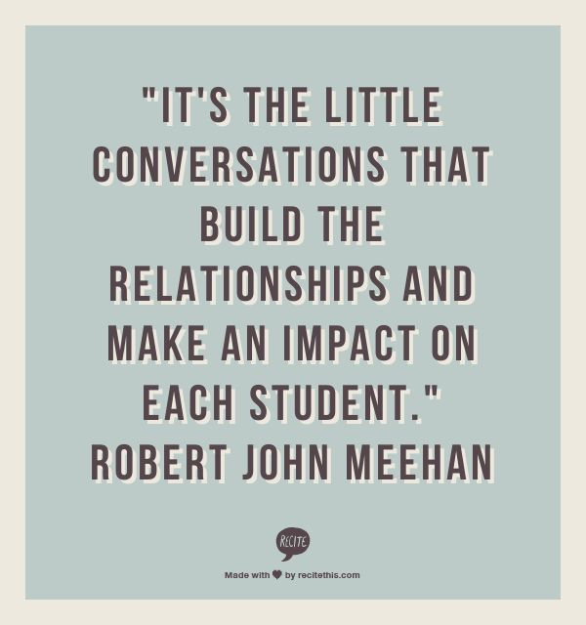
Things to Note
You can customize your questions.
Always acknowledge and thank them who shares.
Make sure they number their answers/drawings with question.
Keep a copy for records if it helps you.

Slide 8
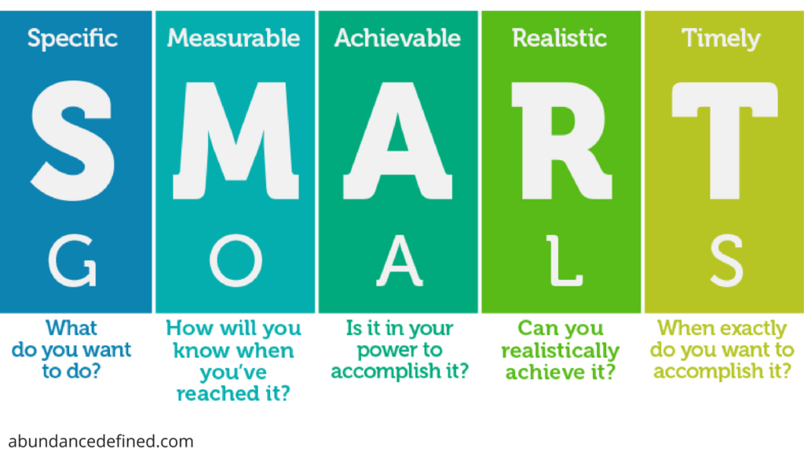
SMART Goals

Slide 9
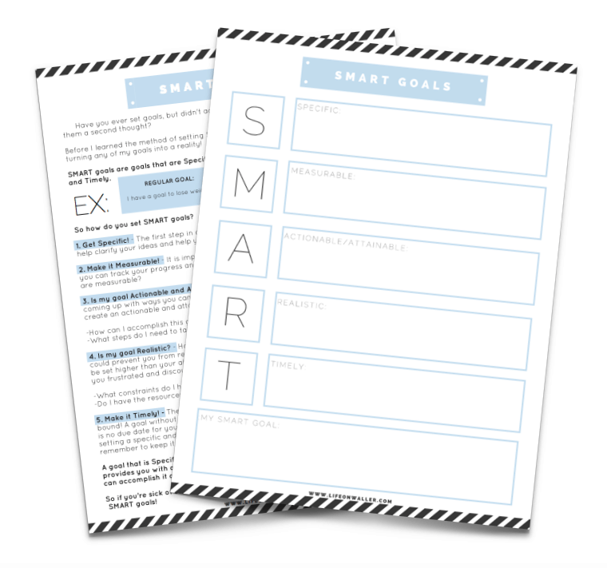
Things to Note
Customize the theme of the goals, is this for a class goal, personal goal, career goal?
Always acknowledge and thank them who shares.
There is a ton of worksheets and resources online for SMART Goals, use them!
Keep a copy for records if it helps you.

Slide 10
2. Be prepared, structured and take notes

Slide 11
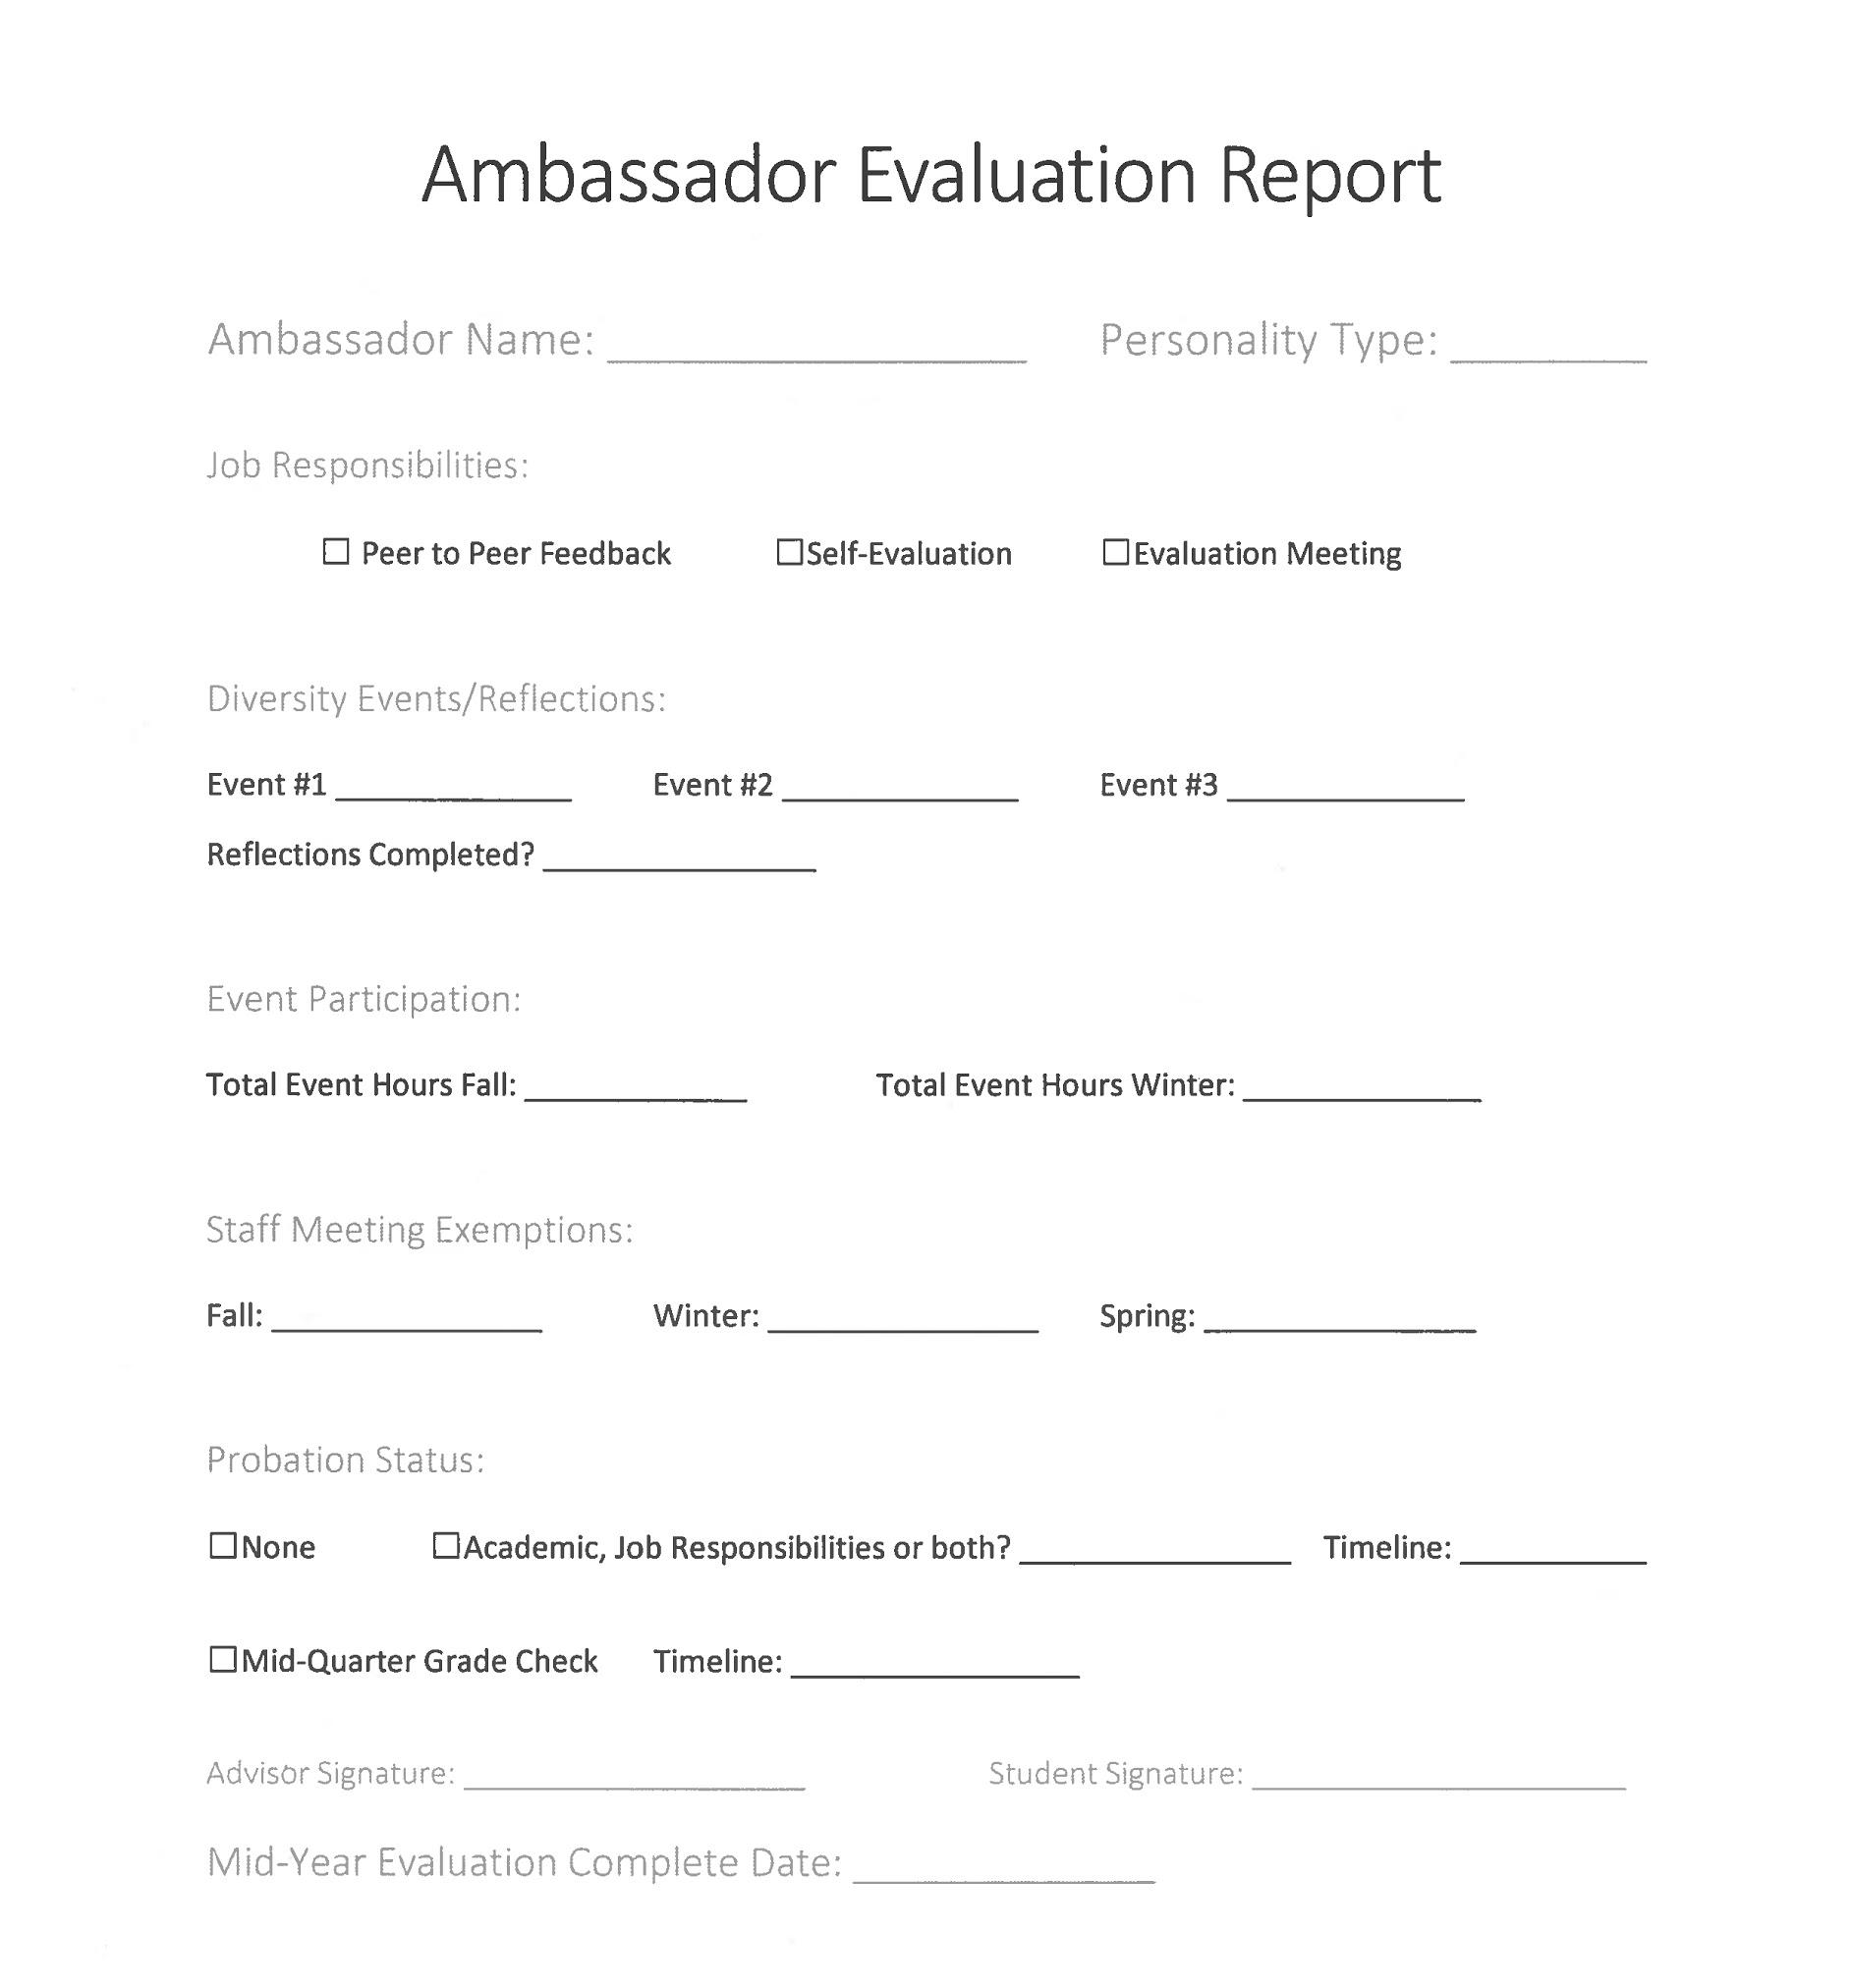
Tips & Tricks
DO: Know who are meeting with, what the structure of your one-on-ones looks like.
Don’t: Double book yourself or take hallway questions during your one-on-one. Show the student their time matters to you.

Slide 12
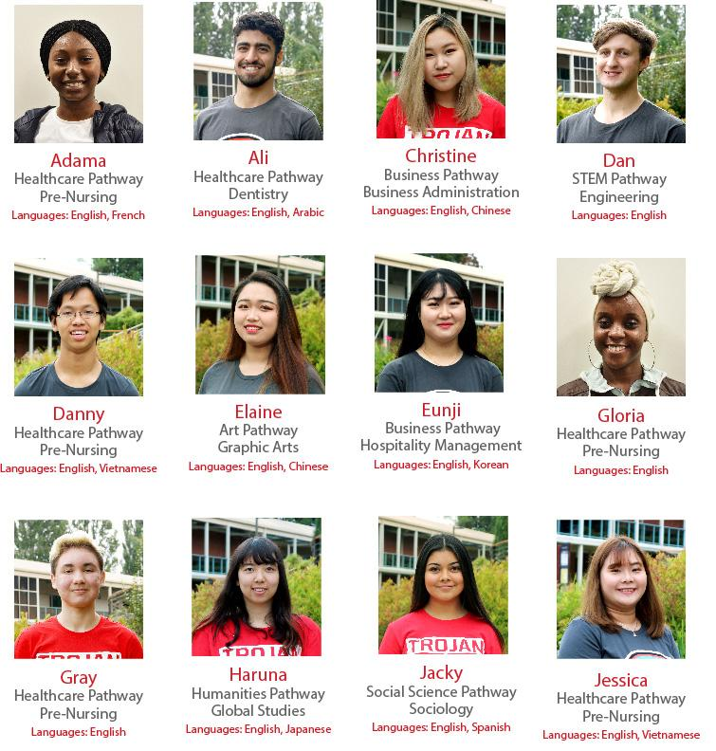
Tips & Tricks
DO: Keep notes. Student names, canvas photo, pathway, personality type.
#1 thing to remember about “remembering”
is that we will forget.
Keep notes!

Slide 13
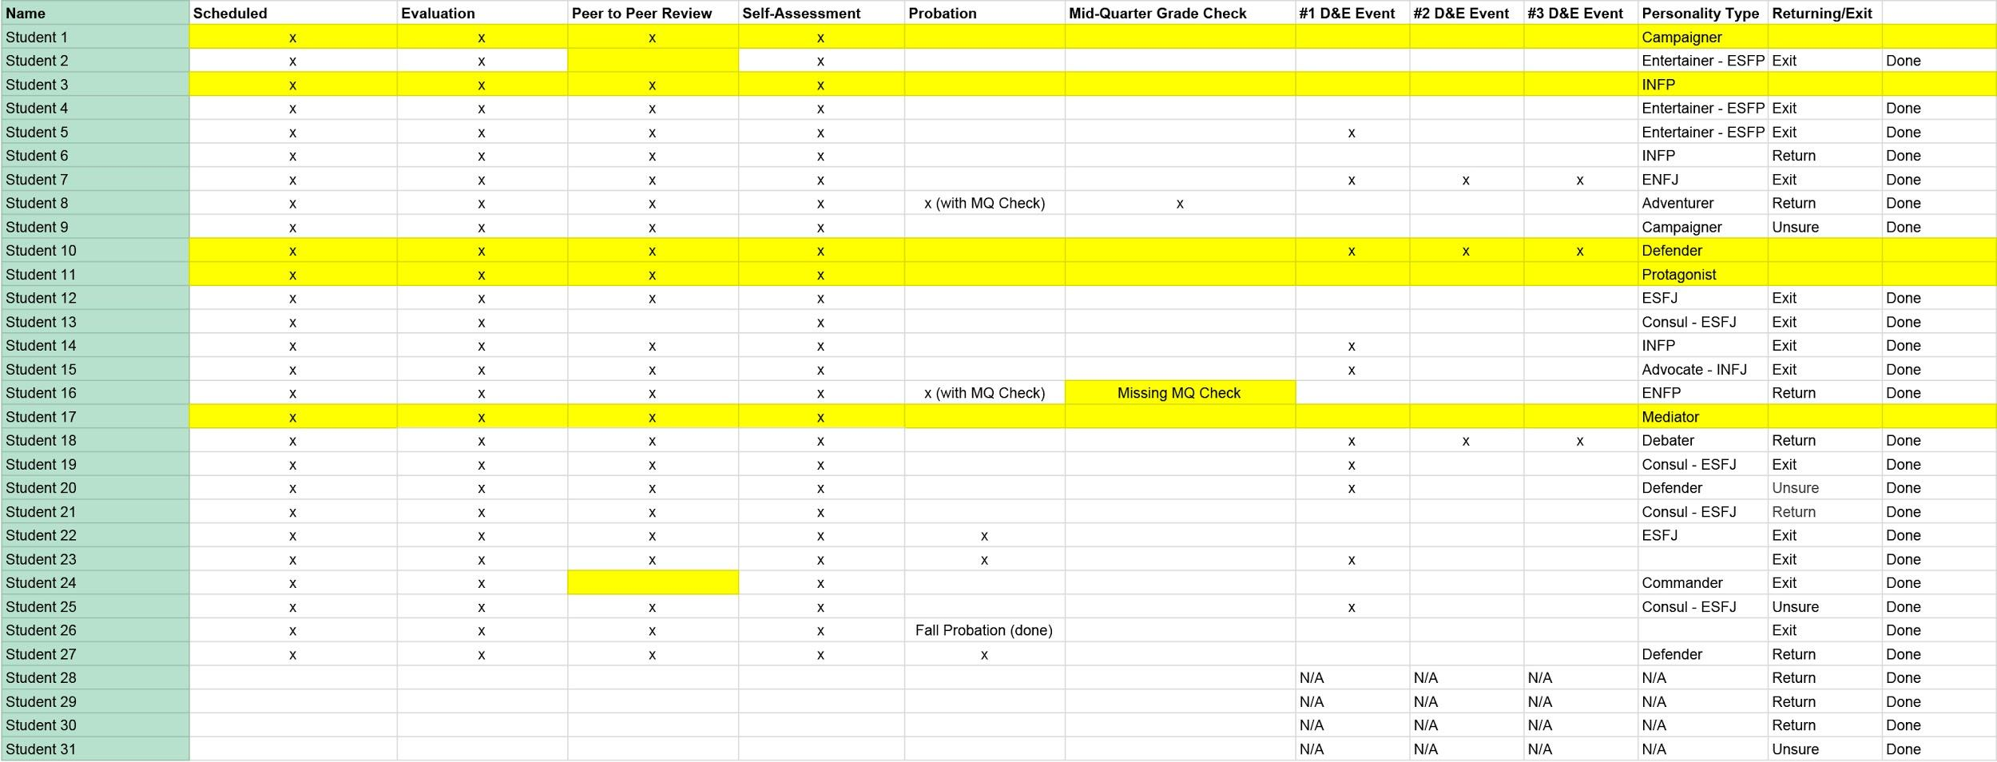
Tips & Tricks
DO: Keep track. I use a spreadsheet but use whatever tools you can.

Slide 14
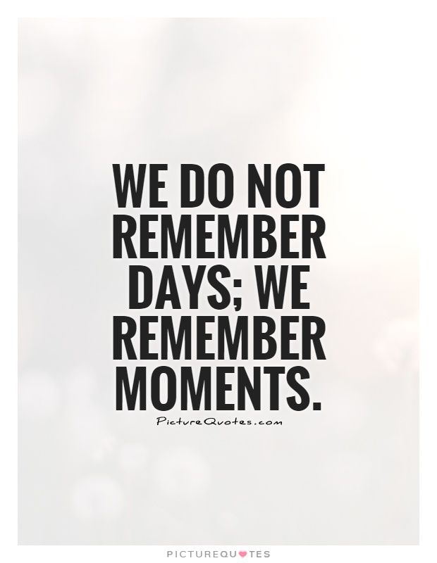
Thank you!

